Slide 1
PYTHON Training
New Organizing Institute
July 19, 2013

Slide 2
Strings and conditionals
Shannon Turner

Slide 3
Identifying and fixing errors
Learn what strings are
Learn how to display and format them
Learn what conditionals are
Learn how to use conditionals to change how your program behaves

Slide 4
Group debugging exercise
Strings
The basics
Slicing
String formatting
String methods

Slide 5
Strings: The basics
Strings are combinations of characters
Letters
Numbers
Punctuation
Basically anything you can make on the keyboard and then some
Special characters, like tabs and newlines

Slide 6
Strings: The basics
How to spot a string: it has quotes around it
"This is a string"
'This is also a string'
You can mix and match single and double quotes – but they’re not completely interchangeable.
"This will give you an error'
'But "this" is entirely okay'

Slide 7
Strings: the basics
Using single or double quotes comes down to personal preference
Sometimes it can make a difference:
"My governor's name is Martin O'Malley"
'She said, "Testing, 1-2-3"'

Slide 8
Strings: the basics
If you have a really long string, use a triple quote (""" or ''') to start your string and the same triple quote to end it
"""Even though this string will span multiple lines, Python isn't going to yell at me – and I can use things like "double and 'single' quotes" without issue."""

Slide 9
Strings: the basics
Special Characters
\n Newline
\t Tab
Escape Characters
\\ Literal Backslash (just one)
\" Literal Double Quote
\' Literal Single Quote

Slide 10

Strings: Quick Exercise
Using a single string, create a variable called output that when you print it, gives the following:
Keep in mind you’ll need to use special characters!

Slide 11
Strings: slicing
first_name = "Shannon"
Slicing lets you see individual pieces or “slices” of your string*
*Slicing also works with lists and dictionaries in the same way. You’ll get to play with lists and dictionaries in later lessons.

Slide 12
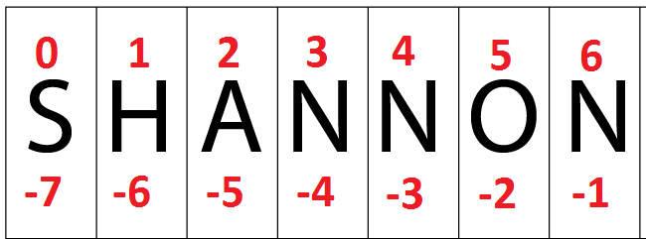
Strings: slicing
first_name = "Shannon"
Simple slices:
first_name[0]
Here, 0 refers to the index that you want to see
Slicing on first_name and last_name can give us a person’s initials

Slide 13
Strings: slicing
You can return more than one item in a slice
first_name[1:5]
The index on the left (1) is where you start
The index on the right (5) is where you end, but Python stops short and doesn’t include it

Slide 14
Strings: slicing
The indices you provide are optional!
first_name[:5]
The left index is not provided, so Python assumes you want to start at the beginning and stop just short of item 5

Slide 15
Strings: slicing
The indices you provide are optional!
first_name[2:]
The right index is not provided, so Python assumes you want to start at item 2 and go to the end

Slide 16
Strings: slicing Exercise
phone = "(123) 456-7890"
Use slicing to print out the middle three numbers

Slide 17
Strings: STRING FORMATTING
"My name is: {0} and my age is: {1} ".format(first_name, age)
Think of the numbers as placeholders for your variables
Remember, Python starts counting at zero. So zero is the first variable, which corresponds to first_name

Slide 18
Strings: formatting Exercise
Write a program to request a 10-digit phone number from a user. Using '.format()' and slicing, print out that phone number in these formats:
Enter your number: 2025559876
Local: 555-9876
Domestic: (202) 555-9876
International: +1-202-555-9876

Slide 19
Strings: STRING Methods
String methods let you perform special actions on your strings
How many characters are in your string
Replace one part of a string with another
Find one part of a string within the string
Count the number of times one part of a string appears within the string

Slide 20
Strings: STRING Methods
email_address = "shannon@notmyreal.one"
email_address.find("@")
Similar to Ctrl+F in most programs
Remember slicing? The number you get back is the index where you found the item! (Unless it’s -1)

Slide 21
Strings: STRING Methods
phone = "555-1245"
phone.replace("1245", "1234")
Simliar to Ctrl+H in most programs
Phone has to be a string – what happens if you leave out the quotes when creating Phone?

Slide 22
Strings: STRING Methods
phone = "555-1245"
phone.replace("1245", "1234")
print phone
Making it stick:
phone = phone.replace("1245", "1234")
print phone

Slide 23
Strings: STRING Methods
phone = "555-1234"
len(phone)
len() works on lists, too!

Slide 24
Strings: STRING Methods
Documentation Time!
Arguments (noun) are what you give to a function or method (action)
len(grocery_list)
"Apples".find("e")

Slide 25
Strings: STRING Methods
Documentation Time!
Functions and methods give you return values when they’re finished so you know what happened.
length = len(grocery_list)
position = "Apples".find("e")

Slide 26
Strings: STRING Methods
Documentation time!
Look up these string methods: strip() lower() upper() count()
http://docs.python.org/2/library/string.html

Slide 27
Strings: EXERCISE
Refer to the handout for instructions.
More string methods are outlined in your handout and at
http://docs.python.org/2/library/string.html

Slide 28
Conditionals
The basics
Operators
Compound conditionals
Using conditionals to change program behavior

Slide 29
cONDITIONALS
Conditional: just a fancy name for a yes or no question
Conditionals are ways to compare things and use that information to make decisions
Conditionals can let you change the behavior of your program

Slide 30
cONDITIONALS
Simple ways to think about conditionals
Is this equal to that?
Is this number less than that number?
Does my phone number have enough numbers?

Slide 31
cONDITIONALS
Conditionals are paired with if statements, which ask whether or not the conditional is true
if age < 21:
True or False, is age less than 21?
If age is less than 21, do this. Otherwise, move on (or do something else!)

Slide 32
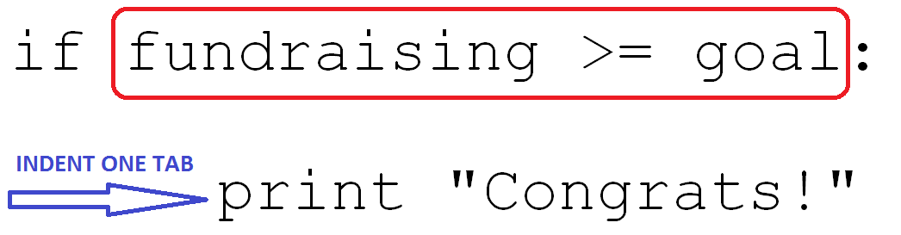
Conditionals: SYntax
Conditionals are paired with if statements
What happens if this condition is true is determined by what’s in the indented block.

Slide 33
cONDITIONALS
Conditionals are similar to the WHERE clause in SQL
SQL: SELECT skills FROM people WHERE name = ‘Shannon’
Python: if (name == ‘Shannon’):
print skills

Slide 34
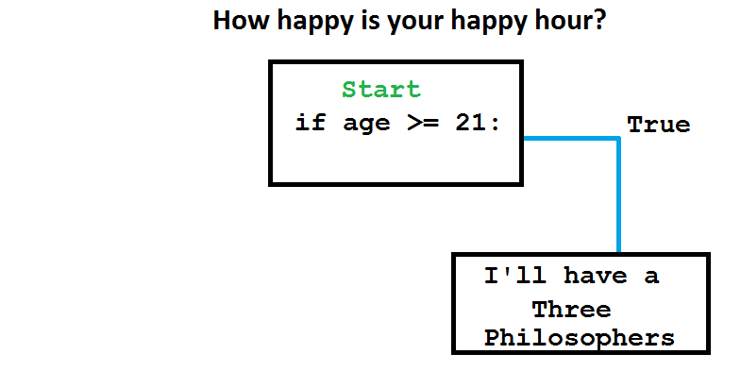
cONDITIONALS

Slide 35
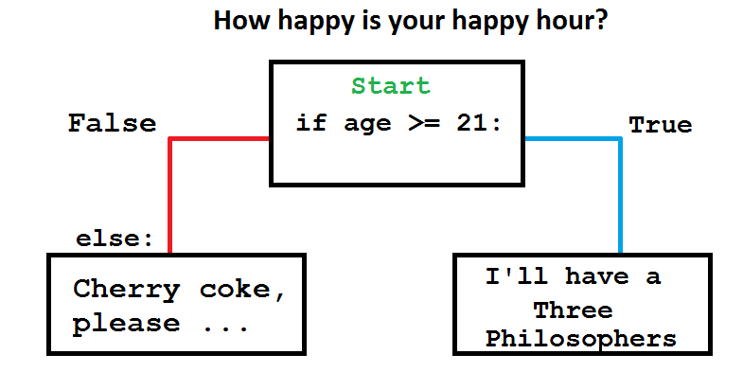
cONDITIONALS

Slide 36
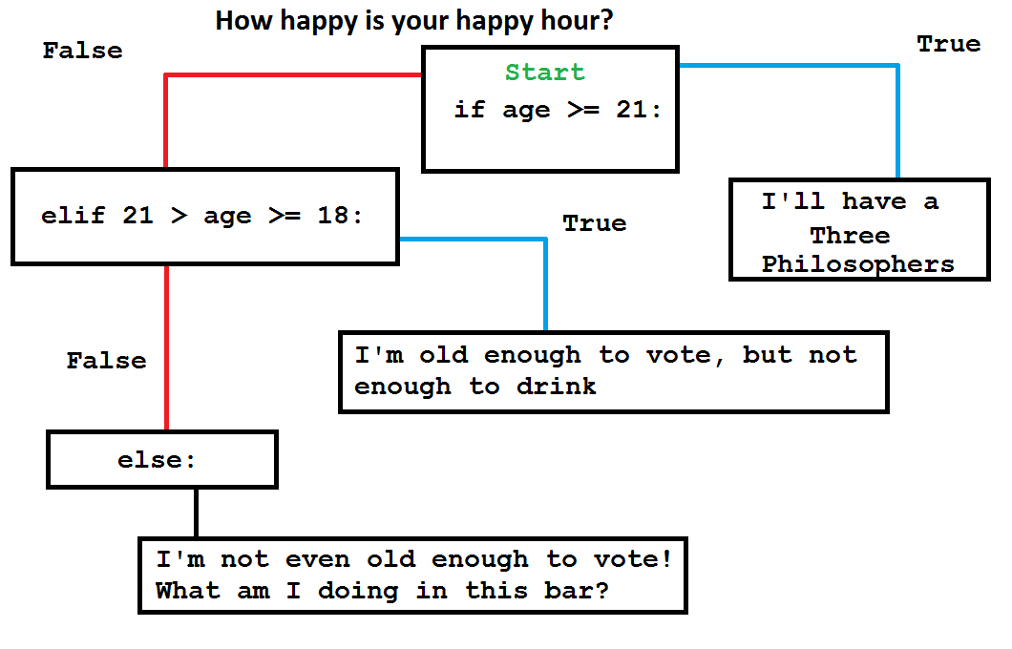
cONDITIONALS

Slide 37
More conditionals
if age >= 21:
# you’re old enough to drink
elif 21 > age >= 18:
# you’re old enough to vote
# but we don’t trust you with a drink
else:
# you’re too young entirely

Slide 38
cONDITIONALS
Operators (ways to compare two things)
== Equality operator (don’t confuse with a single equals sign)
5 == 7 # Python says: False
5 == 5 # Python says: True

Slide 39
cONDITIONALS
Operators (ways to compare two things)
> Greater than operator
5 > 7 # Python says: False
5 > 2 # Python says: True

Slide 40
cONDITIONALS
Operators (ways to compare two things)
== Equality
!= Not equal to
> Greater than
< Less than
>= Greater than or equal to
<= Less than or equal to

Slide 41
cONDITIONALS
if times_volunteered >= 5:
# send them a special thank-you
If ' peanut ' not in volunteer_allergy:
# it ' s okay to bring peanut butter cookies

Slide 42
Compound cONDITIONALS
if times_volunteered >= 5 and volunteer_type == 'Canvasser':
# make them captain
if times_volunteered >= 5 or volunteer_type == 'Captain':
# make them phone bank captain

Slide 43
Conditionals quick exercise
Create a quick calculator program that asks the user for their recruitment goal and their current recruitment numbers. The program should tell the user whether they are at, below, or above their goal.
Example:
Volunteer Recruitment Goal: 126
Current Volunteers: 95
> You are behind, work on recruiting!

Slide 44
Compound cONDITIONALS
if times_volunteered >= 5 or (volunteer_type == 'Phone Banking' and 'fundraising' in volunteer_skills):
# have them ask supporters for money

Slide 45
Compound cONDITIONALS
You can also use your string methods as part of the conditional!
if volunteer_type.strip() == "Canvasser":
# now I don’t mind the extra spaces
# … but without the .strip(), I do
if volunteer_name.lower() == "shannon":
# No matter how it’s CaPItaLIZed

Slide 46
Compound cONDITIONALS
You can also use your string methods as part of the conditional!
if email_address.count("@") > 1:
# this isn’t a valid email

Slide 47
Conditionals: exercise
Refer to the handout for instructions.

